Slide 1

Data Preprocessing and Data Visualization CSE-454: Data Warehousing and Data Mining Sessional
Md. Jakaria
Lecturer
Dept. of CSE, MIST

Slide 2
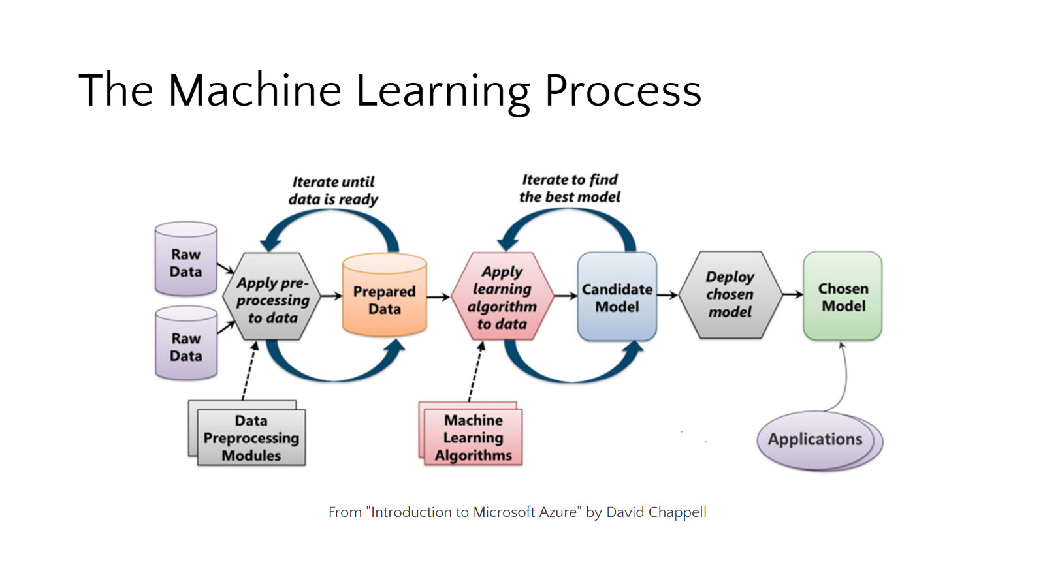
Data Preprocessing
Definition: Data preprocessing is a data mining technique which is used to transform the raw data in a useful and efficient format.
CSE 454: Data Warehousing and Data Mining Sessional

Slide 3
Data Preprocessing
Why we use Data Preprocessing ?
In Real world data are generally-
Incomplete: lacking attribute values, lacking certain attributes of interest, or containing only aggregate data.
Noisy: containing errors or outliers.
Inconsistent: containing discrepancies in codes or names.
Data preprocessing is a proven method of resolving such issues.
CSE 454: Data Warehousing and Data Mining Sessional

Slide 4
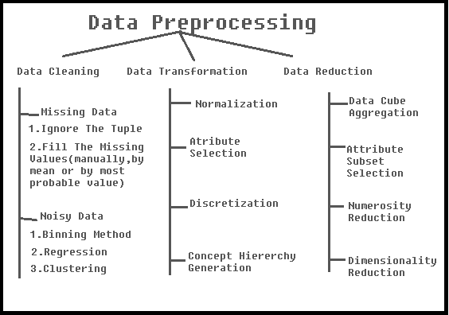
Data Preprocessing
Steps Involved in Data Preprocessing
CSE 454: Data Warehousing and Data Mining Sessional

Slide 5
Data Preprocessing
Steps Involved in Data Preprocessing
1. Data Cleaning
The data can have many irrelevant and missing parts. To handle this part, data cleaning is done. It involves handling of missing data, noisy data etc.
(a) Missing Data
This situation arises when some data is missing in the data. It can be handled in various ways.
Ignore the tuple
This approach is suitable only when the dataset we have is quite large and multiple values are missing within a tuple
Fill the Missing values:
There are various ways to do this task. You can choose to fill the missing values manually, by attribute mean or the most probable value.
CSE 454: Data Warehousing and Data Mining Sessional

Slide 6
Data Preprocessing
(b) Noisy Data
Noisy data is a meaningless data that can’t be interpreted by machines. It can be generated due to faulty data collection, data entry errors etc.
Binning Method
This method works on sorted data in order to smooth it. The whole data is divided into segments of equal size and then various methods are performed to complete the task. Each segmented is handled separately. One can replace all data in a segment by its mean or boundary values can be used to complete the task.
Regression
Here data can be made smooth by fitting it to a regression function. The regression used may be linear (having one independent variable) or multiple (having multiple independent variables).
Clustering
This approach groups the similar data in a cluster. The outliers may be undetected or it will fall outside the clusters.
CSE 454: Data Warehousing and Data Mining Sessional

Slide 7
Data Preprocessing
2. Data Transformation
This step is taken in order to transform the data in appropriate forms suitable for mining process.
Normalization
It is done in order to scale the data values in a specified range (-1.0 to 1.0 or 0.0 to 1.0)
Attribute Selection
In this strategy, new attributes are constructed from the given set of attributes to help the mining process.
Discretization
This is done to replace the raw values of numeric attribute by interval levels or conceptual levels.
Concept Hierarchy Generation
Here attributes are converted from level to higher level in hierarchy. For Example-The attribute “city” can be converted to “country”.
CSE 454: Data Warehousing and Data Mining Sessional

Slide 8
Data Preprocessing
3. Data Reduction
While working with huge volume of data, analysis became harder. To get rid of this, we uses data reduction technique, which aims to increase the storage efficiency and reduce data storage and analysis costs.
(a) Data Cube Aggregation
Aggregation operation is applied to data for the construction of the data cube.
(b) Attribute Subset Selection
The highly relevant attributes should be used, rest all can be discarded.
(c) Numerosity Reduction
This enable to store the model of data instead of whole data, for example: Regression Models.
(d) Dimensionality Reduction
This reduce the size of data by encoding mechanisms. The two effective methods are: Wavelet transforms and PCA
CSE 454: Data Warehousing and Data Mining Sessional

Slide 9
Data Preprocessing
Features in Machine Learning
A dataset can be viewed as a collection of data objects, which are often also called as a records, points, vectors, patterns, events, cases, samples, observations, or entities.
Data objects are described by a number of features, that capture the basic characteristics of an object, such as the mass of a physical object or the time at which an event occurred, etc.. Features are often called as variables, characteristics, fields, attributes, or dimensions.
“A feature is an individual measurable property or characteristic of a phenomenon being observed”
CSE 454: Data Warehousing and Data Mining Sessional

Slide 10
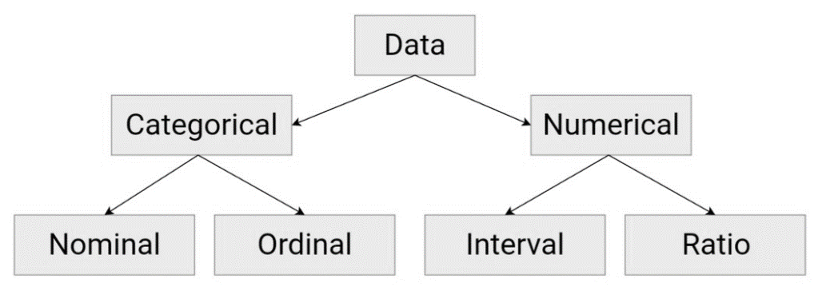
Data Preprocessing
Statistical Data Types
Categorical: Features whose values are taken from a defined set of values. Ex., days in a week : {Mon, Tue, Wed, Thu, Fri, Sat, Sun}. Another example could be the Boolean set : {True, False}
Numerical: Features whose values are continuous or integer-valued. They are represented by numbers and possess most of the properties of numbers. For instance, number of steps you walk in a day, or the speed at which you are driving your car at.
CSE 454: Data Warehousing and Data Mining Sessional

Slide 11
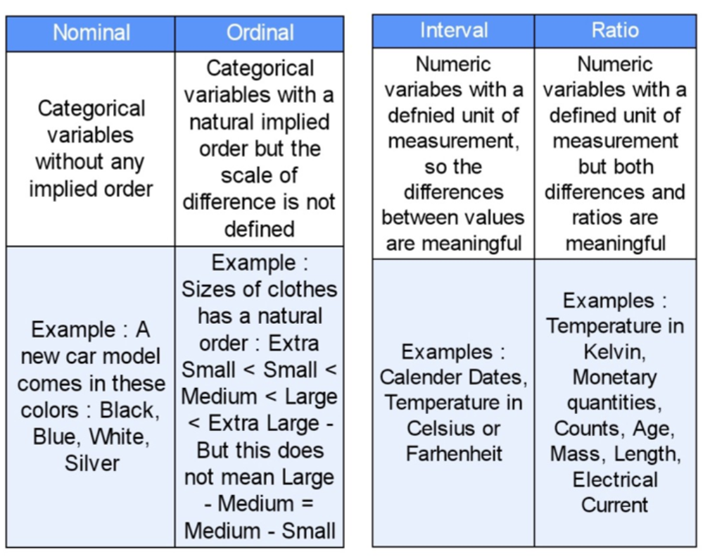
Data Preprocessing
Statistical Data Types
CSE 454: Data Warehousing and Data Mining Sessional

Slide 12
Data Preprocessing
Data Splitting
After necessary preprocessing, our dataset is ready for the exciting machine learning algorithms! But before we start deciding the algorithm which should be used, it is always advised to split the dataset into 2 or sometimes 3 parts.
Training data: This is the part on which your machine learning algorithms are actually trained to build a model. The model tries to learn the dataset and its various characteristics and intricacies, which also raises the issue of Overfitting v/s Underfitting.
Validation data: This is the part of the dataset which is used to validate our various model fits. In simpler words, we use validation data to choose and improve our model hyperparameters. The model does not learn the validation set but uses it to get to a better state of hyperparameters.
Test data: This part of the dataset is used to test our model hypothesis. It is left untouched and unseen until the model and hyperparameters are decided, and only after that the model is applied on the test data to get an accurate measure of how it would perform when deployed on real-world data.
CSE 454: Data Warehousing and Data Mining Sessional

Slide 13
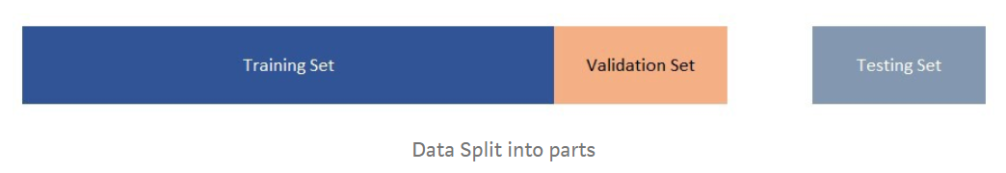
Data Preprocessing
Data Splitting
After necessary preprocessing, our dataset is ready for the exciting machine learning algorithms! But before we start deciding the algorithm which should be used, it is always advised to split the dataset into 2 or sometimes 3 parts.
CSE 454: Data Warehousing and Data Mining Sessional

